Slide 1

Neural Networks and Deep Learning Logistic Regression – Neural Networks- Backpropagation
Presented by
Dr. T. Hitendra Sarma
Associate Professor
Department of Information Technology
Vasavi College of Engineering, Hyderabad

Slide 2
Outline
Logistic Regression (Recap)
Neural Networks
Backpropagation

Slide 3
Plan of the talk
Define a linear classifier (logistic regression)
Define an objective function (likelihood)
Optimize it with gradient descent to learn parameters
Predict the class with highest probability under the model

Slide 4
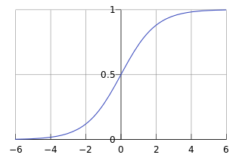
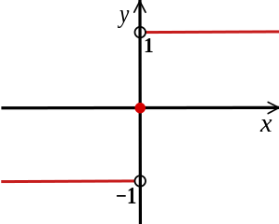
Using gradient ascent for linear classifiers
This decision function isn’t differentiable:
Use a differentiable function instead:
sign(x)

Slide 5
Using gradient ascent for linear classifiers
This decision function isn’t differentiable:
Use a differentiable function instead:
sign(x)

Slide 6

Logistic Regression
Data: Inputs are continuous vectors of length K. Outputs are discrete.
Model: Logistic function applied to dot product of parameters with input vector.
Learning: finds the parameters that minimize some objective function.
Prediction: Output is the most probable class.

Slide 7
Neural Networks

Slide 8
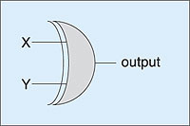
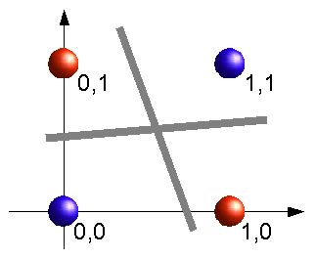
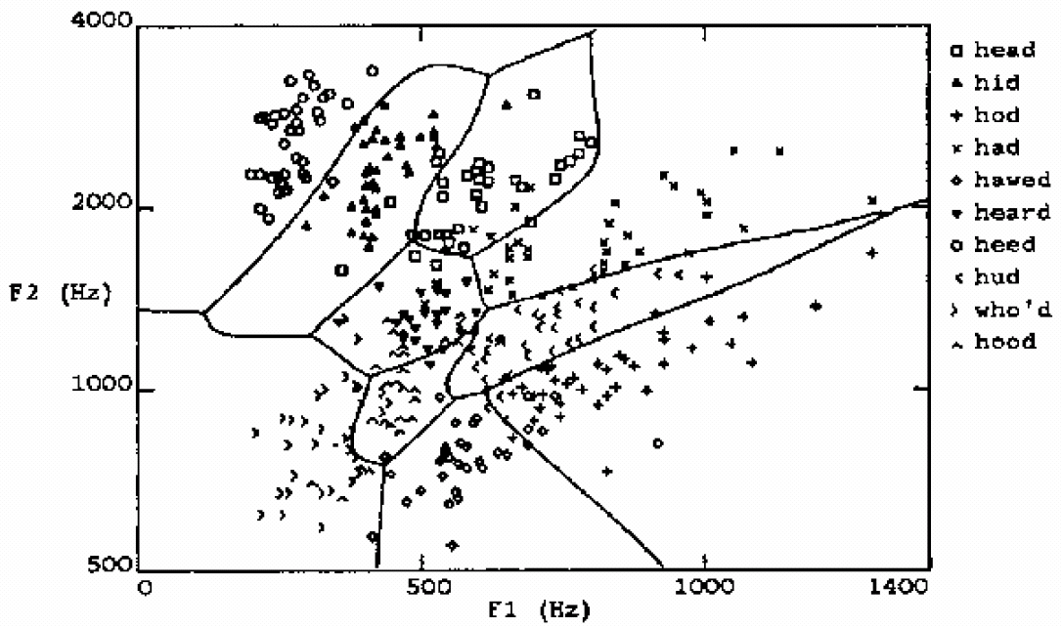
Learning highly non-linear functions
f: X → Y
f might be non-linear function
X (vector of) continuous and/or discrete vars
Y (vector of) continuous and/or discrete vars
The XOR gate
Speech recognition

Slide 9
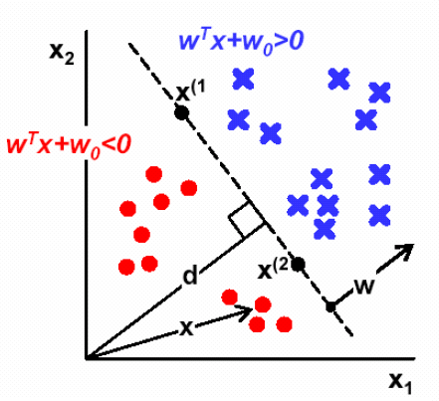
Perceptron and Neural Nets
From biological neuron to artificial neuron (perceptron)
Activation function
Artificial neuron networks
supervised learning
gradient descent

Slide 10
Connectionist Models
Consider humans:
Neuron switching time
~ 0.001 second
Number of neurons
~ 10¹⁰
Connections per neuron
~ 10⁴⁻⁵
Scene recognition time
~ 0.1 second
100 inference steps doesn't seem like enough
→ much parallel computation
Properties of artificial neural nets (ANN)
Many neuron-like threshold switching units
Many weighted interconnections among units
Highly parallel, distributed processes

Slide 11

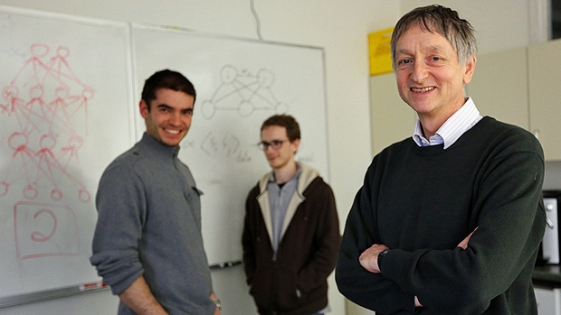


Why is everyone talking about Deep Learning?
Motivation
Because a lot of money is invested in it…
DeepMind: Acquired by Google for $400 million
DNNResearch: Three person startup (including Geoff Hinton) acquired by Google for unknown price tag
Enlitic, Ersatz, MetaMind, Nervana, Skylab: Deep Learning startups commanding millions of VC dollars
Because it made the front page of the New York Times

Slide 12
Why is everyone talking about Deep Learning?
Motivation
1960s
Deep learning:
Has won numerous pattern recognition competitions
Does so with minimal feature engineering
1980s
1990s
This wasn’t always the case!
Since 1980s: Form of models hasn’t changed much, but lots of new tricks…
More hidden units
Better (online) optimization
New nonlinear functions (ReLUs)
Faster computers (CPUs and GPUs)
2006
2016
Notes:
TODO: Cut this.

Slide 13


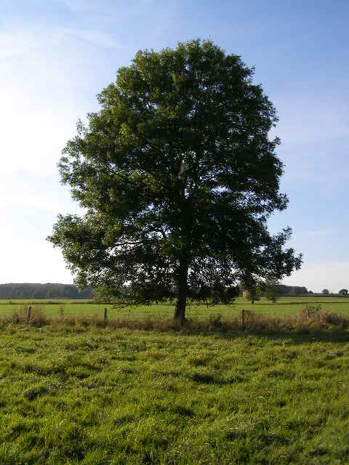
A Recipe for Machine Learning
Background
1. Given training data:
Face
Face
Not a face
2. Choose each of these:
Decision function
Loss function
Examples: Linear regression, Logistic regression, Neural Network
Examples: Mean-squared error, Cross Entropy

Slide 14
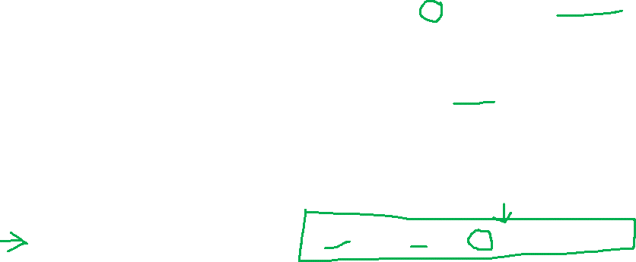

A Recipe for Machine Learning
Background
1. Given training data:
3. Define goal:
2. Choose each of these:
Decision function
Loss function
4. Train with SGD:
(take small steps opposite the gradient)

Slide 15
A Recipe for Machine Learning
Background
Gradients
1. Given training data:
3. Define goal:
Backpropagation can compute this gradient!
And it’s a special case of a more general algorithm called reverse-mode automatic differentiation that can compute the gradient of any differentiable function efficiently!
2. Choose each of these:
Decision function
Loss function
4. Train with SGD:
(take small steps opposite the gradient)

Slide 16
A Recipe for Machine Learning
Background
Goals for Today’s Lecture
1. Given training data:
3. Define goal:
Explore a new class of decision functions (Neural Networks)
Consider variants of this recipe for training
2. Choose each of these:
Decision function
Loss function
4. Train with SGD:
(take small steps opposite the gradient)

Slide 17
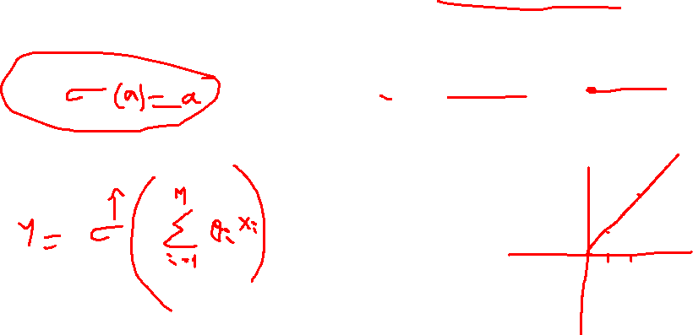
Linear Regression
Decision Functions
y
Output
θ₁
θ₂
θ₃
θ_{M}
x₁
x₂
x₃
…
x_{M}
Input

Slide 18
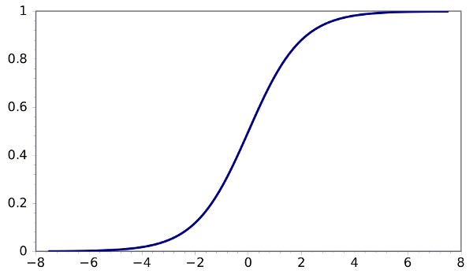
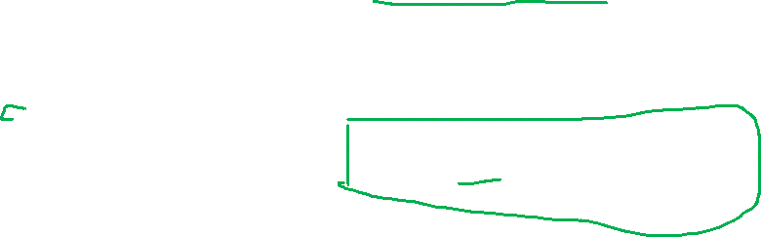
Logistic Regression
Decision Functions
y
Output
θ₁
θ₂
θ₃
θ_{M}
x₁
x₂
x₃
…
x_{M}
Input

Slide 19
Logistic Regression
Decision Functions
y
Output
Face
Face
Not a face
θ₁
θ₂
θ₃
θ_{M}
x₁
x₂
x₃
…
x_{M}
Input

Slide 20
Logistic Regression
Decision Functions
y
Output
1
1
0
y
θ₂
θ₃
θ_{M}
x₂
θ₁
x₁
x₁
x₂
x₃
…
x_{M}
Input

Slide 21
Logistic Regression
Decision Functions
y
Output
θ₁
θ₂
θ₃
θ_{M}
x₁
x₂
x₃
…
x_{M}
Input

Slide 22
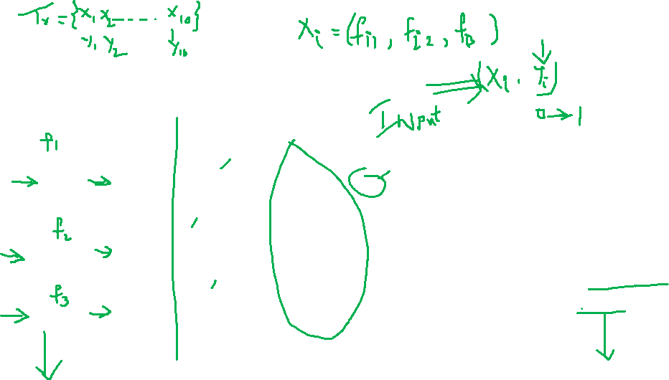
Neural Network Model
Inputs
Output
Age
34
.6
.4
.2
Σ
0.6
.1
.5
Gender
2
Σ
.3
.2
.8
.7
Σ
“Probability of beingAlive”
Stage
4
.2
Dependent variable
Prediction
Independent variables
Weights
HiddenLayer
Weights

Slide 23
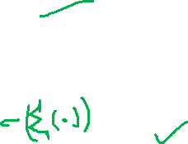
“Combined logistic models”
Inputs
Output
Age
34
.6
.5
0.6
.1
Gender
2
Σ
.7
.8
“Probability of beingAlive”
Stage
4
Dependent variable
Prediction
Independent variables
Weights
HiddenLayer
Weights

Slide 24
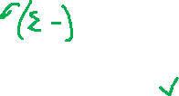
Inputs
Output
Age
34
.2
.5
0.6
Gender
2
Σ
.3
.8
“Probability of beingAlive”
Stage
4
.2
Dependent variable
Prediction
Independent variables
Weights
HiddenLayer
Weights

Slide 25
Inputs
Output
Age
34
.6
.2
.5
0.6
.1
Gender
1
Σ
.3
.7
.8
“Probability of beingAlive”
Stage
4
.2
Dependent variable
Prediction
Independent variables
Weights
HiddenLayer
Weights

Slide 26
Not really, no target for hidden units...
Age
34
.6
.4
.2
Σ
0.6
.1
.5
Gender
2
Σ
.3
.2
.8
.7
Σ
“Probability of beingAlive”
Stage
4
.2
Dependent variable
Prediction
Independent variables
Weights
HiddenLayer
Weights

Slide 27
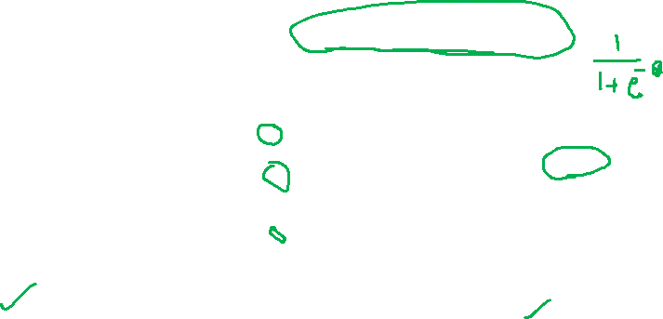
Jargon Pseudo-Correspondence
Independent variable = input variable
Dependent variable = output variable
Coefficients = “weights”
Estimates = “targets”
Logistic Regression Model (the sigmoid unit)
Inputs
Output
Age
34
5
0.6
Gender
1
4
Σ
“Probability of beingAlive”
Stage
4
8
Independent variables
x1, x2, x3
Coefficients
a, b, c
Dependent variable
p Prediction

Slide 28
Neural Network
Decision Functions
y
Output
a₁
a₂
…
a_{D}
Hidden Layer
x₁
x₂
x₃
…
x_{M}
Input
Notes:
TODO: Include the math on the right.
TODO: Show the parameters.

Slide 29
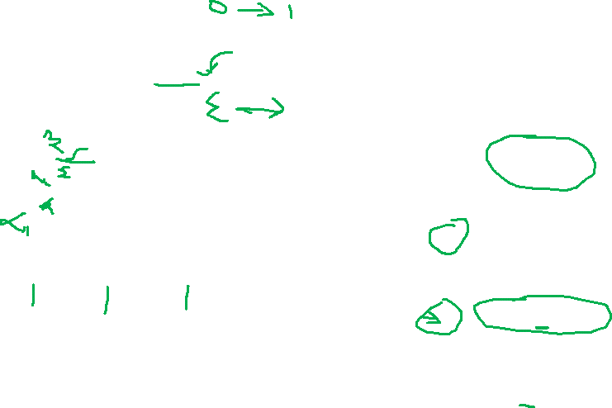
Neural Network
Decision Functions
Output
y
Hidden Layer
z₁
z₂
…
z_{D}
Input
x₁
x₂
x₃
…
x_{M}

Slide 30
Building a Neural Net
y
Output
x₁
x₂
…
x_{M}
Features
Notes:
This is regular perceptron

Slide 31
Building a Neural Net
y
Output
a₁
a₂
…
a_{D}
Hidden Layer
D = M
1
1
1
x₁
x₂
…
x_{M}
Input
Notes:
What if we connect all the X to all the Z?

Slide 32

Building a Neural Net
y
Output
a₁
a₂
…
a_{D}
Hidden Layer
D = M
x₁
x₂
…
x_{M}
Input
Notes:
What if we connect all the X to all the Z?

Slide 33
Building a Neural Net
y
Output
a₁
a₂
…
a_{D}
Hidden Layer
D = M
x₁
x₂
…
x_{M}
Input
Notes:
What if we connect all the X to all the Z?

Slide 34

Building a Neural Net
y
Output
a₁
a₂
…
a_{D}
Hidden Layer
D < M
x₁
x₂
x₃
…
x_{M}
Input
Notes:
What if we connect all the X to all the Z?

Slide 35

Decision Boundary
0 hidden layers: linear classifier
Hyperplanes
Example from to Eric Postma via Jason Eisner

Slide 36
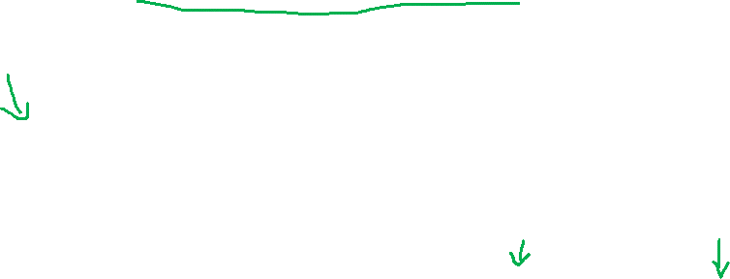
Decision Boundary
1 hidden layer
Boundary of convex region (open or closed)
Example from to Eric Postma via Jason Eisner
Notes:
We saw with XOR

Slide 37
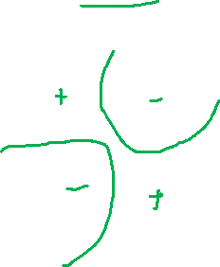
Decision Boundary
2 hidden layers
Combinations of convex regions
Example from to Eric Postma via Jason Eisner

Slide 38
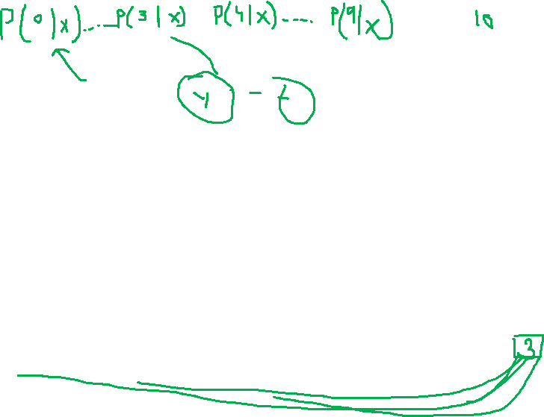
Multi-Class Output
Decision Functions
y₁
…
y_{K}
Output
a₁
a₂
…
a_{D}
Hidden Layer
x₁
x₂
x₃
…
x_{M}
Input
Notes:
Why called feed forward?

Slide 39
Deeper Networks
Decision Functions
Next lecture:
Output
y
Hidden Layer 1
a₁
a₂
…
a_{D}
Input
x₁
x₂
x₃
…
x_{M}

Slide 40
Deeper Networks
Decision Functions
Next lecture:
Output
y
Hidden Layer 2
b₁
b₂
…
b_{E}
Hidden Layer 1
a₁
a₂
…
a_{D}
Input
x₁
x₂
x₃
…
x_{M}

Slide 41
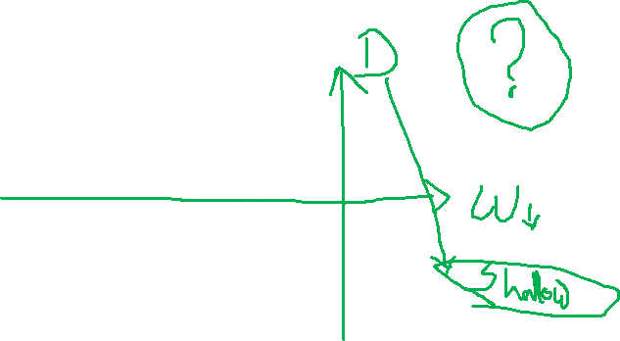
Deeper Networks
Decision Functions
Next lecture: Making the neural networks deeper
Output
y
Hidden Layer 3
c₁
c₂
…
c_{F}
Hidden Layer 2
b₁
b₂
…
b_{E}
Hidden Layer 1
a₁
a₂
…
a_{D}
Input
x₁
x₂
x₃
…
x_{M}

Slide 42
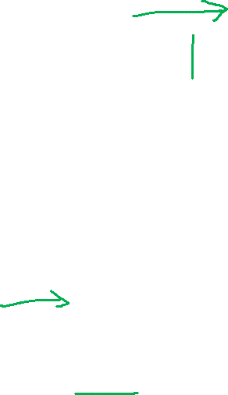
Different Levels of Abstraction
Decision Functions
We don’t know the “right” levels of abstraction
So let the model figure it out!
Example from Honglak Lee (NIPS 2010)
Notes:
TODO: Make pixels greyscle
TODO: Increase size of 1st hidden layer

Slide 43
Different Levels of Abstraction
Decision Functions
Face Recognition:
Deep Network can build up increasingly higher levels of abstraction
Lines, parts, regions
Example from Honglak Lee (NIPS 2010)
Notes:
TODO: Make pixels greyscle
TODO: Increase size of 1st hidden layer

Slide 44

Different Levels of Abstraction
Decision Functions
Output
y
Hidden Layer 3
c₁
c₂
…
c_{F}
Hidden Layer 2
b₁
b₂
…
b_{E}
Hidden Layer 1
a₁
a₂
…
a_{D}
Input
x₁
x₂
x₃
…
x_{M}
Example from Honglak Lee (NIPS 2010)

Slide 45
Architectures

Slide 46

Neural Network Architectures
Even for a basic Neural Network, there are many design decisions to make:
# of hidden layers (depth)
# of units per hidden layer (width)
Type of activation function (nonlinearity)
Form of objective function

Slide 47

Activation Functions
Neural Network with sigmoid activation functions
Output
y
Hidden Layer
z₁
z₂
…
z_{D}
Input
x₁
x₂
x₃
…
x_{M}

Slide 48
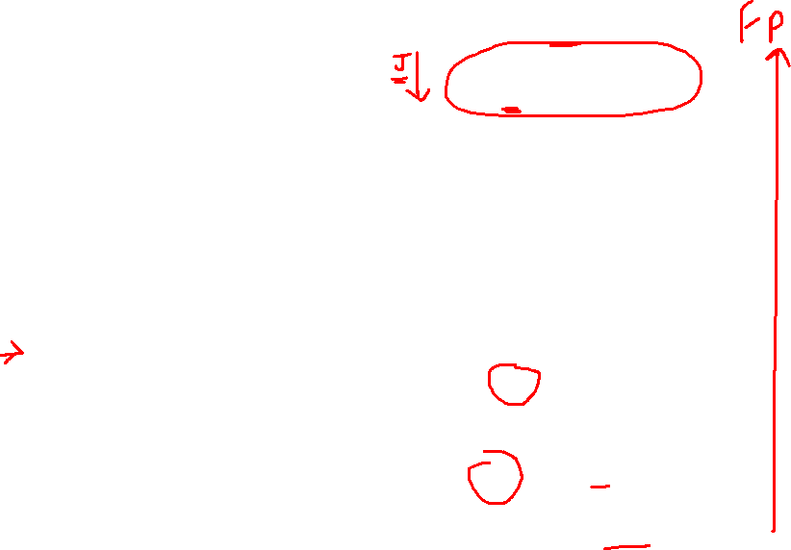
Activation Functions
Neural Network with arbitrary nonlinear activation functions
Output
y
Hidden Layer
z₁
z₂
…
z_{D}
Input
x₁
x₂
x₃
…
x_{M}

Slide 49
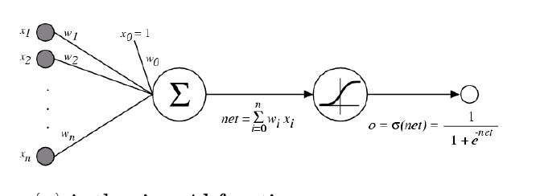
Activation Functions
Sigmoid / Logistic Function
So far, we’ve assumed that the activation function (nonlinearity) is always the sigmoid function…

Slide 50
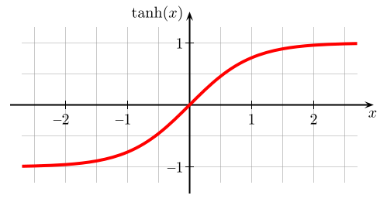
Activation Functions
A new change: modifying the nonlinearity
The logistic is not widely used in modern ANNs
Alternate 1: tanh
Like logistic function but shifted to range [-1, +1]
Slide from William Cohen

Slide 51
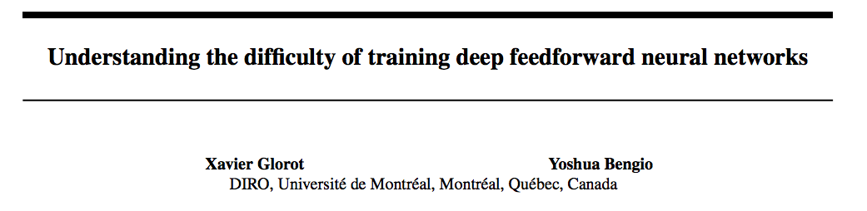
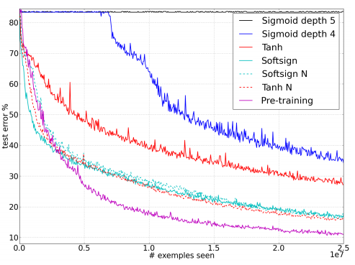
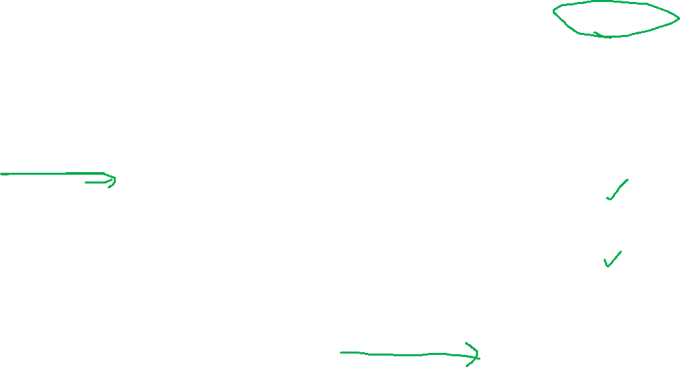
AI Stats 2010
depth 4?
sigmoid vs. tanh
Figure from Glorot & Bentio (2010)

Slide 52
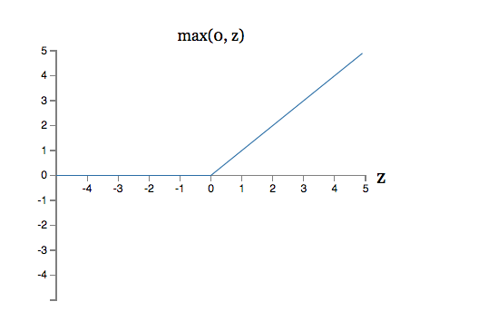
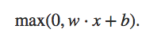


Activation Functions
A new change: modifying the nonlinearity
reLU often used in vision tasks
Alternate 2: rectified linear unit
Linear with a cutoff at zero
(Implementation: clip the gradient when you pass zero)
Slide from William Cohen

Slide 53
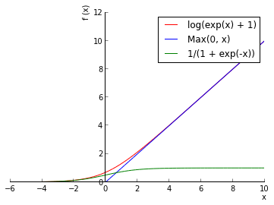
Activation Functions
A new change: modifying the nonlinearity
reLU often used in vision tasks
Alternate 2: rectified linear unit
Soft version: log(exp(x)+1)
Doesn’t saturate (at one end)
Sparsifies outputs
Helps with vanishing gradient
Slide from William Cohen

Slide 54
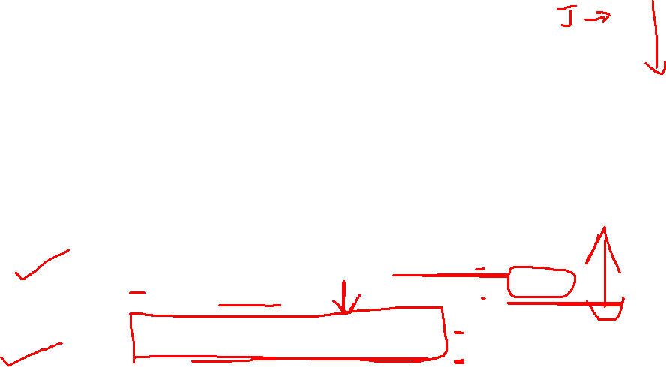
Objective Functions for NNs
Regression:
Use the same objective as Linear Regression
Quadratic loss (i.e. mean squared error)
Classification:
Use the same objective as Logistic Regression
Cross-entropy (i.e. negative log likelihood)
This requires probabilities, so we add an additional “softmax” layer at the end of our network

Slide 55
Multi-Class Output
y₁
…
y_{K}
Output
a₁
a₂
…
a_{D}
Hidden Layer
x₁
x₂
x₃
…
x_{M}
Input
Notes:
Why called feed forward?

Slide 56
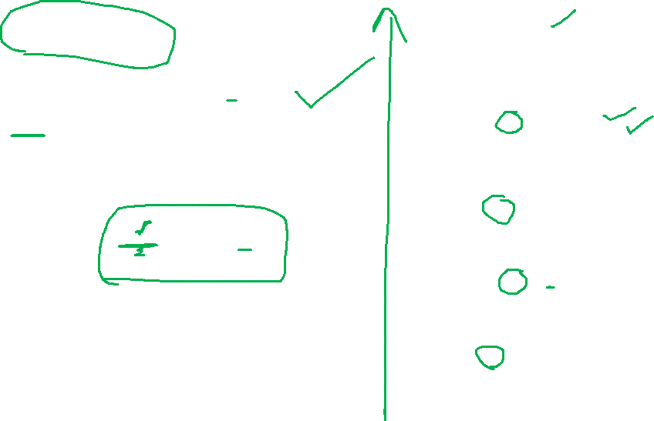
Multi-Class Output
Softmax:
y₁
…
y_{K}
Output
Hidden Layer
a₁
a₂
…
a_{D}
Input
x₁
x₂
x₃
…
x_{M}
Notes:
Why called feed forward?

Slide 57
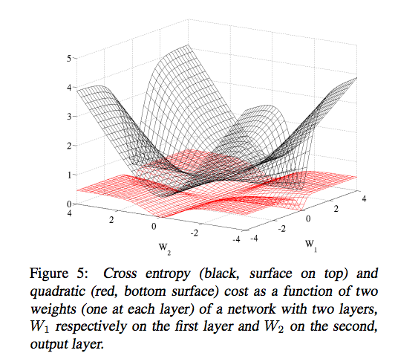
Cross-entropy vs. Quadratic loss
Figure from Glorot & Bentio (2010)

Slide 58
A Recipe for Machine Learning
Background
1. Given training data:
3. Define goal:
2. Choose each of these:
Decision function
Loss function
4. Train with SGD:
(take small steps opposite the gradient)

Slide 59
Objective Functions
Matching Quiz: Suppose you are given a neural net with a single output, y, and one hidden layer.
1) Minimizing sum of squared errors…
2) Minimizing sum of squared errors plus squared Euclidean norm of weights…
3) Minimizing cross-entropy…
4) Minimizing hinge loss…
5) …MLE estimates of weights assuming target follows a Bernoulli with parameter given by the output value
6) …MAP estimates of weights assuming weight priors are zero mean Gaussian
7) …estimates with a large margin on the training data
8) …MLE estimates of weights assuming zero mean Gaussian noise on the output value
…gives…
1=5, 2=7, 3=6, 4=8
1=5, 2=7, 3=8, 4=6
1=7, 2=5, 3=5, 4=7
1=7, 2=5, 3=6, 4=8
1=8, 2=6, 3=5, 4=7
1=8, 2=6, 3=8, 4=6

Slide 60
Backpropagation

Slide 61
A Recipe for Machine Learning
Background
1. Given training data:
3. Define goal:
2. Choose each of these:
Decision function
Loss function
4. Train with SGD:
(take small steps opposite the gradient)

Slide 62
Backpropagation
Training
Question 1: When can we compute the gradients of the parameters of an arbitrary neural network?
Question 2: When can we make the gradient computation efficient?

Slide 63
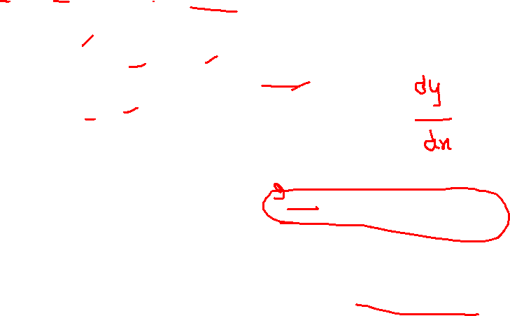
Chain Rule
Training
Given:
Chain Rule:
y₁
u₁
u₂
…
u_{J}
x₂

Slide 64

Chain Rule
Training
Given:
Chain Rule:
y₁
Backpropagation is just repeated application of the chain rule from Calculus.
u₁
u₂
…
u_{J}
x₂

Slide 65
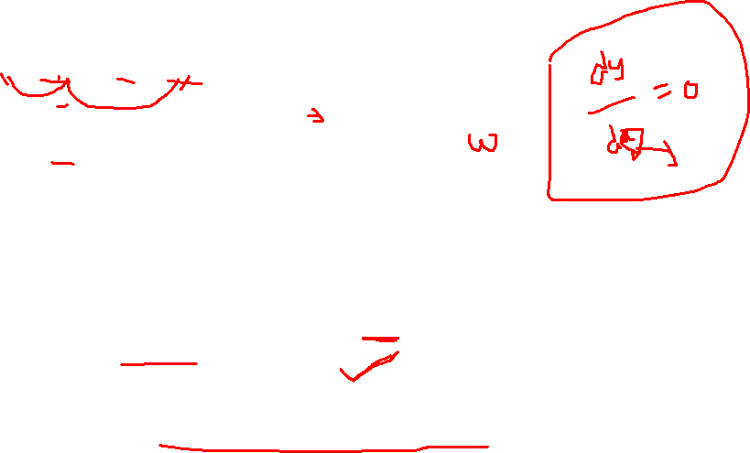
Chain Rule
Training
y₁
Given:
Chain Rule:
u₁
u₂
…
u_{J}
x₂
Backpropagation:
Instantiate the computation as a directed acyclic graph, where each intermediate quantity is a node
At each node, store (a) the quantity computed in the forward pass and (b) the partial derivative of the goal with respect to that node’s intermediate quantity.
Initialize all partial derivatives to 0.
Visit each node in reverse topological order. At each node, add its contribution to the partial derivatives of its parents
This algorithm is also called automatic differentiation in the reverse-mode

Slide 66
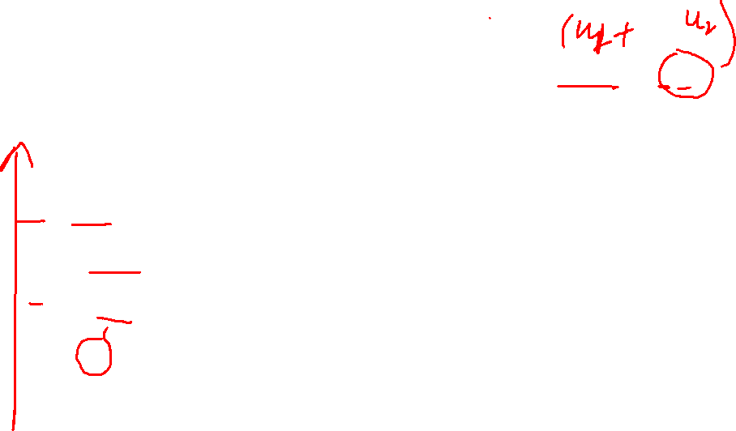
Backpropagation
Training

Slide 67
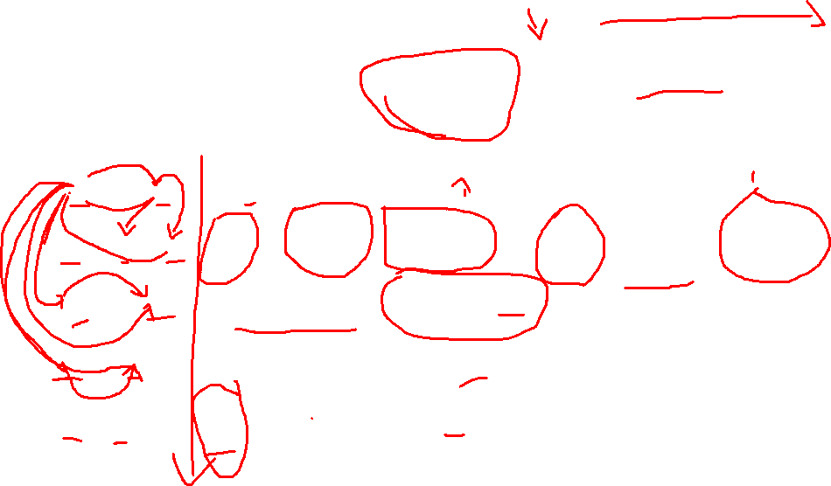
Backpropagation
Training

Slide 68
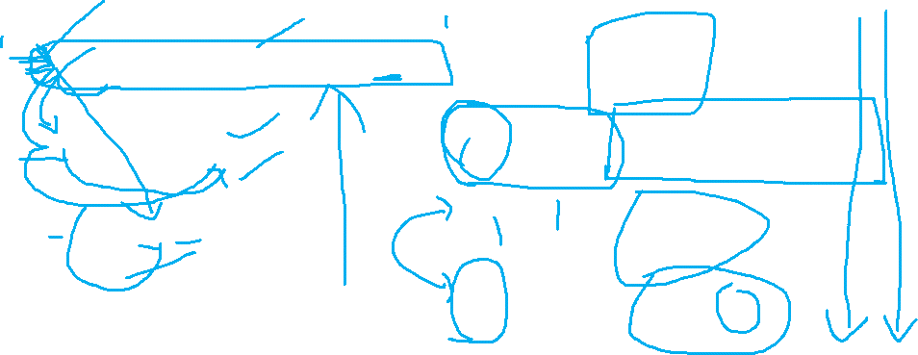
Backpropagation
Training
Output
y
Case 1:
Logistic Regression
θ₁
θ₂
θ₃
θ_{M}
Input
x₁
x₂
x₃
…
x_{M}

Slide 69
Backpropagation
Training
Output
y
Hidden Layer
z₁
z₂
…
z_{D}
Input
x₁
x₂
x₃
…
x_{M}

Slide 70
Backpropagation
Training
Output
y
Hidden Layer
z₁
z₂
…
z_{D}
Input
x₁
x₂
x₃
…
x_{M}

Slide 71
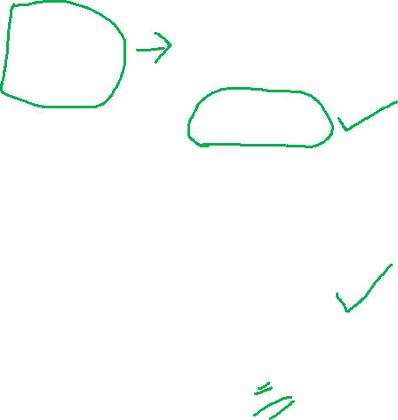
Backpropagation
Training
Case 2:
Neural Network
y
z₁
z₂
…
z_{D}
x₁
x₂
x₃
…
x_{M}

Slide 72
Chain Rule
Training
y₁
Given:
Chain Rule:
u₁
u₂
…
u_{J}
x₂
Backpropagation:
Instantiate the computation as a directed acyclic graph, where each intermediate quantity is a node
At each node, store (a) the quantity computed in the forward pass and (b) the partial derivative of the goal with respect to that node’s intermediate quantity.
Initialize all partial derivatives to 0.
Visit each node in reverse topological order. At each node, add its contribution to the partial derivatives of its parents
This algorithm is also called automatic differentiation in the reverse-mode

Slide 73
Chain Rule
Training
y₁
Given:
Chain Rule:
u₁
u₂
…
u_{J}
x₂
Backpropagation:
Instantiate the computation as a directed acyclic graph, where each node represents a Tensor.
At each node, store (a) the quantity computed in the forward pass and (b) the partial derivatives of the goal with respect to that node’s Tensor.
Initialize all partial derivatives to 0.
Visit each node in reverse topological order. At each node, add its contribution to the partial derivatives of its parents
This algorithm is also called automatic differentiation in the reverse-mode

Slide 74
Backpropagation
Training
Case 2:
Neural Network
Module 5
Module 4
y
z₁
z₂
…
z_{D}
Module 3
x₁
x₂
x₃
…
x_{M}
Module 2
Module 1

Slide 75

A Recipe for Machine Learning
Background
Gradients
1. Given training data:
3. Define goal:
Backpropagation can compute this gradient!
And it’s a special case of a more general algorithm called reverse-mode automatic differentiation that can compute the gradient of any differentiable function efficiently!
2. Choose each of these:
Decision function
Loss function
4. Train with SGD:
(take small steps opposite the gradient)

Slide 76
Summary
Neural Networks…
provide a way of learning features
are highly nonlinear prediction functions
(can be) a highly parallel network of logistic regression classifiers
discover useful hidden representations of the input
Backpropagation…
provides an efficient way to compute gradients
is a special case of reverse-mode automatic differentiation

Slide 77


Thanks to Dr Matt Gormley, School of Computer Science from Carnegie Mellon University, for making presentation public accessible for teaching.
Acknowledgements

